Slide 1
Agile software requirements
2017

Slide 2
Agenda and learning objectives
Understand the relation between quality, requirements and acceptance test
Have formulated user stories for the Airline Booking system or your own project
Have formulated User acceptance tests

Slide 3
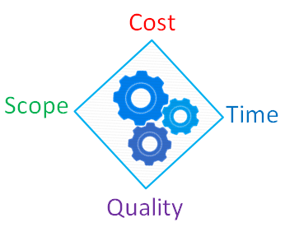
Quality
– what we do not compromise
Software quality is a complex mix of factors, which vary depending on the applications and the customers who demand them
Functional software quality reflect the extent to which the software corresponds to or satisfy a given design based on functional requirements or specifications
Structural software quality indicates the extent to which software meets the non-functional requirements that support the delivery of the functional requirements such as robustness, maintainability, the degree of how correct software is made
There are a number of implicit requirements rarely mentioned (eg. usability)
If the software meets the explicit requirements, but not the implicit, the software quality debatable

Slide 4
Functional and non-functional requirements
Functional requirements
"A requirement specifies a function that a system or component must be able to perform.“
Can be specified in different ways:
XP: User stories test cases
UP: Use cases
…: Features list
Non-functional requirements
"A non-functional requirement is a statement of how a system must behave, it is a constraint upon the systems behaviour."
Non-functional requirements specify the requirements not covered by the functional requirements
They specify criteria accessing the use of the system rather than a specific behaviour
Ex.: "Display of the students' satisfaction level must appear within 2 milliseconds."

Slide 5
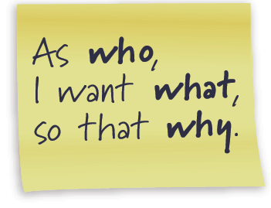
User stories
Formulated by PO
Estimated by the team
Used as basis for sprint planning/planning game
For each user story in the sprint back the PO must create test scenarios
Scope (PO)
Estimate (team)
Importance (PO)

Slide 6
Invest in good User Stories
Independent
A story can be developed, tested and potentially delivered on it’s own
Negotiable
A story is a placeholder for discussion, development, test and acceptance
Valuable
Stories are prioritized by value and succeeds or fails based on the value it provides
Estimable
If a story cannot be estimated due to largeness – it should be split
If a story cannot be estimated due to uncertainty – a functional spikes can help reduce uncertainty
Small
Stories must be small enough to be completed in an iteration
Testable
All code is tested code

Slide 7
Videos
Explaining Agile - Martin Fowler and Neil Ford at USI
https://www.youtube.com/watch?v=GE6lbPLEAzc
Agile Product Ownership in a nutshell
http://www.youtube.com/watch?v=502ILHjX9EE
Product Backlog Grooming Meeting
http://scrumtrainingseries.com/

Slide 8
For the project
Formulate 2 to 4 user stories for your project
Estimate the user stories

Slide 9
Accept test

Slide 10
Main categories of testing
A business-facing test is one you could describe to a business expert in terms that would (or should) interest her . . . . You use words drawn from the business domain:
“If you withdraw more money than you have in your account, does the system automatically extend you a loan?”
A technology-facing test is one you describe with words drawn from the domain of the programmers:
“Different browsers implement JavaScript differently, so we test whether our product works with the most important ones.”

Slide 11
The agile testing matrix
Manual because they
involve users and testers
Developers

Slide 12
Accepttest definition
Acceptance tests described black-box requirements
Identified by your project stakeholders
Which your system must conform to
Acceptance tests are first class requirements artifacts because they describe the criteria by which stakeholders will determine whether the system meets their needs
They're executable specifications
Acceptance test is also called:
Customer (Acceptance) Tests
Functionality test
“Conditions of satisfaction"

Slide 13
Acceptance Test Driven Development - ATDD
A development methodology based on communication between the business customers, the developers, and the testers
ATDD encompasses acceptance testing, but highlights writing acceptance tests before developers begin coding
ATDD is closely related to Test-Driven Development
It differs by the emphasis on developer-tester-business customer collaboration

Slide 14
Conduction of accept test
Let the customer/end user carry out the test
Do not demonstrate the product your self
Have following roles:
A facilitator
Gives instructions to the user
Without influencing the test
Encourages the users to express their thoughts during the test
The only member og the development team who speaks during the test
A secretary (at least one) who takes notes during the test
Silent observers for the rest of the team

Slide 15
Acceptance Test Driven Development - ATDD

Slide 16
Acceptance Tests
Acceptance tests are created from user stories
During an iteration the user stories selected during the iteration planning meeting will be translated into acceptance tests
The acceptance test specifies scenarios to test when a user story has been correctly implemented
A story can have one or many acceptance tests, what ever it takes to ensure the functionality works
Acceptance tests are black box system tests

Slide 17

Acceptance test anti-patterns
Developers writing acceptance tests by themselves, for themselves
Don’t write Acceptance test at unit testing level
Unit tests are implementation specific
Acceptance tests are independent of implementation
Writing tests after the code is finished

Slide 18
ATDD - Acceptance criteria
Is a set of conditions that the story must meet for it to be accepted as complete
It’s not a replacement for conversation with the product owner
It’s the result of the conversation
Format:
Given [precondition] (setup)
A specified state of a system
When [Actor + Action](trigger)
An action or event occurs
Then [Observable result](verification)
The state of the system has changed or an output has been produced

Slide 19
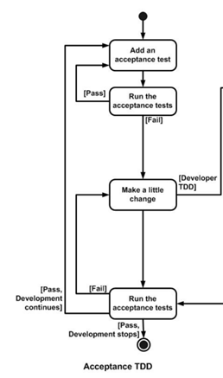
Acceptance test
Acceptation criteria are NOT tests
Acceptance criteria
+ Examples (data + scenarios)
= Acceptance tests

Slide 20
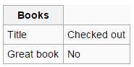
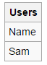
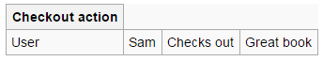
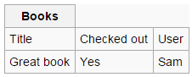
ATDD
- Acceptance criteria example
Check out book: “As a user, I want to check out a book from the library so that I can bring it home to read”
Given: Book that has not been checked out & User who is registered on the system
When: User checks out a book
Then: Book is marked as checked out
What if the book is already checked out?
What if the book does not exist?
What if the user is not registered on the system?
Is there a date that the book is due to be checked-in?
How many books can a user check out?

Slide 21
Assignment
Write a user story related to the your semester project, it has to contain:
Name
Description
Acceptance criteria

Slide 22
Test Driven Development
TDD

Slide 23
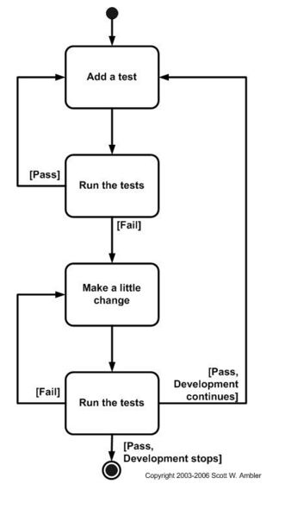
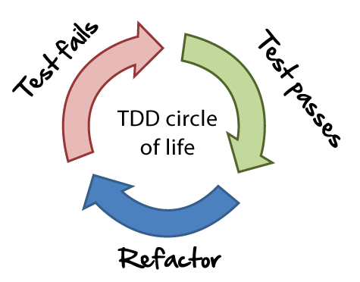
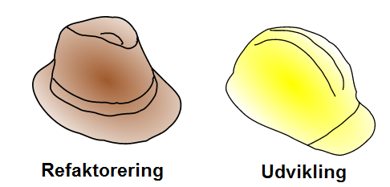
Test Driven Development
Test Driven Design
TDD = TFD + Refactoring Test First Development

Slide 24
Test Driven Design
TDD completely turns traditional development around
The first question that you ask is whether the existing design is the best design possible that enables you to implement that functionality
If so, you proceed via a TFD approach
If not, you refactor it locally to change the portion of the design affected by the new feature
As a result you will always be improving the quality of your design, thereby making it easier to work with in the future
Requires great discipline because it is easy to “slip” and write functional code without first writing a new

Slide 25
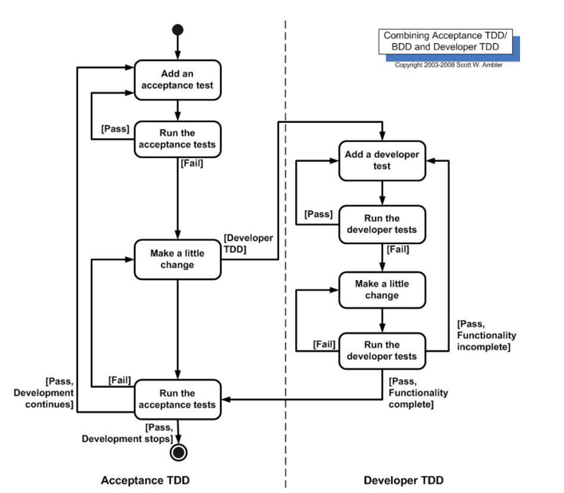
Combining TDD and ATTD

Slide 26
Introducing the Sample Application
The sample application is a classic login example:
At the moment, the sample application allows a user to do two things:
Create an account with a password
Log in with a valid user name and password
Attempting to log in with a non-existent user account or with an invalid password results in the same error message: Access Denied
Creating a user account results in the message: Success
Logging in successfully results in the message: Logged In

Slide 27
Backlog sample application
The next story on the prioritized backlog is:
Users are required to use secure passwords
(strings of at least 6 characters with at least one letter, one number, and one symbol)
During the Planning Meeting we discuss the story about secure passwords, we ask the business stakeholder requesting the feature questions intended to elicit acceptance criteria:
What should happen if a user enters an insecure password?
Can you give me examples of passwords you consider secure and insecure?
What are examples of “symbols”?
What about spaces?
What about dictionary words with obvious substitutions that meet the criteria but still may be insecure, like “p@ssw0rd”?
What about existing accounts?
How will you know this feature “works”?

Slide 28
For the project
Make user acceptance tests for the user stories you created on the project

